Slide 1
Badhan Automated System Management

Slide 2
Use Case

Slide 3
Subsystems
Subsystems | Scope
1. Database Management | Managing donor , member and user database
2. Search Management | Searching nearest Badhan zone, donor availability search, member search
3. Meeting Management | Managing events, discussions , presenting new proposals , analyzing monthly/yearly reports etc
4. Notification Management | Managing notification subsystems
5. Automated Requisition Form | Providing an interface for automated requisition form verification

Slide 4
Actors
User
Donor
Unit Member
Zonal Member
Central Member
Moderator ( All Zonal Presidents & Club Moderators)
Admin (Central Badhan President)
Advisor
Hospital Representative
Time (System)

Slide 5
Actors Glossary
Actors | Short-Key | Activity Scope
User | USR | Check Availability & Makes Blood Call
Donor | DNR | Donate Blood & Update Info
Unit Member | UM | Authenticate ,Search , Confirm Blood Calls
Zonal Member | ZM | Monitor Unit Activities
Central Member | CM | Monitor Zonal Activities
Moderator | MOD | Verify Accounts
Admin | ADM | Control Whole System
Advisor | ADV | Gives Direction & Occasional Financial Support
Hospital Representative | HR | Verify Scanned Requisition Form

Slide 6
1. Database Management
Use-Case ID > Name | Description | Participant Actors
1.1 > Volunteer for Donation | Donor volunteers for blood donation and informs a unit member | Donor fills up form and unit member receives request
1.2 > Add Donor | Unit member adds donor if found eligible for blood donation | Unit member updates donor database
1.3 > Remove Donor | Unit member removes donor from database if donor no longer available for further blood donation | Unit member
1.4 > Donor Update Regarding Donation | Donor informs unit member after a blood donation | Unit member and donor
1.5 > Donor Database Update | Unit member updates donor database | Unit member
1.6 > User Database Management | Zonal members conducts modifications to user database | Zonal committee member
1.7 > Member Database Management | Club moderator maintains member database | Moderator

Slide 7
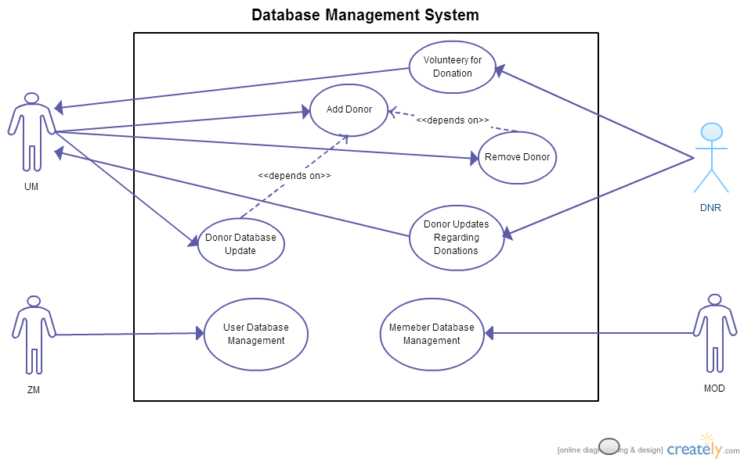
Fig : Use-Case Diagram for Database Management System

Slide 8
1.1 Volunteery for Donation
Use-Case Name | Volunteery for Donation
Use-Case ID | 1.1
Priority | High
Primary Business Actor | Donor(DNR)
External Receiver Actor | Unit Member(UM)
Description | Donor volunteers for blood donation and informs a unit member
Trigger | By DNR
Table : Use Case Narrative 1.1

Slide 9
1.1 Typical Course of Events
Actor Action | System Response
1. Donor volunteers for donation | 2. Request to be forwarded to a unit member
3. Unit member receives a donor request

Slide 10
1.1 Documentation of Use-Case Volunteery for Donation
Conclusion : Concludes when a unit member receives the request for blood donation volunteer
Post Condition : Unit member checks donor’s eligibility for blood donation
Implementation Issue : Interested donors can fill up forms online and submit request for becoming a donor. This process can also be done manually, in person

Slide 11
1.2 Add Donor
Use-Case Name | Add Donor
Use-Case ID | 1.2
Priority | High
Primary System Actor | Unit Member(UM)
Description | Unit member adds new donor information in database
Trigger | By UM
Typical Course of Event | Unit member adds new donor to database
Table : Use Case Narrative 1.2

Slide 12
1.2 Documentation of Use-Case Add Donor
Conclusion : Concludes when a unit member makes entry in database regarding information of new donor
Post Condition : Donor information is added to database
Implementation Issue : System contains the donor database. Unit member makes entry to this database from their account

Slide 13
1.3 Remove Donor
Use-Case Name | Remove Donor
Use-Case ID | 1.3
Priority | High
Primary System Actor | Unit Member(UM)
Description | Unit member removes donor information if donor no longer can donate blood(Example scenario: donor left the education institute)
Trigger | By UM
Typical Course of Event | Unit member removes donor from database
Table : Use Case Narrative 1.3

Slide 14
1.3 Documentation of Use-Case Remove Donor
Conclusion : Concludes after the unit member makes a deletion of a donor entry from donor database
Pre Condition : Target donor has been added to database before
Post Condition : A donor record is erased from donor database
Implementation Issue : System contains donor database. Unit members can erase a donor from their account

Slide 15
1.4 Donor Updates Regarding Donation
Use-Case Name | Donor Updates Regarding Donation
Use-Case ID | 1.4
Priority | Medium
Primary Business Actor | Donor(DNR)
External Receiver Actor | Unit Member(UM)
Description | Donor informs unit member after a blood donation or other info (Example – contact/room no change etc)
Trigger | By DNR
Typical Course of Event | Donor informs a unit member of recent blood donation or concerning updates possibly by filling up a form online or informing unit member in person
Table : Use Case Narrative 1.4

Slide 16
1.4 Documentation of Use-Case Donor Updates Regarding Donation
Conclusion : Concludes when a unit member receives update of recent blood donation from a donor
Post Condition : Unit member updates donor database

Slide 17
1.5 Donor Database Update
Use-Case Name | Donor Database Update
Use-Case ID | 1.5
Priority | High
Primary Business Actor | Unit Member(UM)
Description | Unit member updates donor records regarding latest donation or other donor details
Trigger | By UM
Typical Course of Event | Unit member updates donor records regarding latest donation or other donor details
Table : Use Case Narrative 1.5

Slide 18
1.5 Documentation of Use-Case Donor Database Update
Conclusion : Concludes after unit member updates donor information in database
Pre Condition : Target donor has been added to database before
Post Condition : Donor database up-to-date
Implementation Issue : Donor database can be accessed by unit members and they can update existing records

Slide 19
1.6 User Database Management
Use-Case Name | User Database Management
Use-Case ID | 1.6
Priority | Medium
Primary Business Actor | Zonal Committee Member(ZM)
Description | During blood calls, zonal members check user database for user’s previous records. New user added. Update information on existing user.
Trigger | By ZM
Table : Use Case Narrative 1.6

Slide 20
1.6 Typical Course of Events
Actor Action | System Response
1. User makes a blood call
2. Zonal member receives blood call
3. Zonal member authenticates user and searches user database | 4. No user entry in the system
5. Zonal member adds new user to database | 6. New user added

Slide 21
1.6 Alternate Course of Events
Actor Action | System Response
1. User makes a blood call
2. Zonal member receives blood call
3. Zonal member authenticates user and searches user database | 4. System returns user information
5. User information from database helps zonal member for authentication
6. Zonal member updates user information on database regarding current blood call | 7. User database up-to-date

Slide 22
1.6 Documentation of Use-Case User Database Management
Conclusion : Concludes when a zonal committee member makes an entry or modifies an entry in user database
Post Condition : User database is up-to-date containing blood call records for users
Implementation Issue : User database is contained in the system. Zonal committee members can log-in to their account to update user database

Slide 23
1.7 Member Database Management
Use-Case Name | User Database Management
Use-Case ID | 1.7
Priority | High
Primary Business Actor | Moderator(MOD)
Description | Moderator adds or removes members and updates member information(Example : member promotion)
Trigger | By MOD
Typical Course of Events | Adds new member Removes existing member Updates record of existing member
Table : Use Case Narrative 1.7

Slide 24
1.7 Documentation of Use-Case Member Database Management
Conclusion : Concludes when a club moderator makes an entry or modification or removal of a member record
Post Condition : Member database is up-to-date
Implementation Issue : Club moderator has access to members database. He can alter records in the database

Slide 25
Q&A
Any Questions ?

Slide 26
Thank You

Slide 27
2. Search Management System
Use-Case ID > Name | Description | Participant Actors
2.1 > Donor Availability Check | Returns Specific Donor Availability in the Nearest Badhan Zone | USR, CM
2.2 > Unit Donor Availability List | Returns Available Donor List of the Respective Unit | UM
2.3 > Zonal Donor Availability List | Returns Available Donor List of the Respective Zone | ZM
2.4 > Member Search | Search & Returns All Current or Previous Badhan Members Information & Unit / zonal / Central Committee List | UM,ZM,CM,ADV

Slide 28
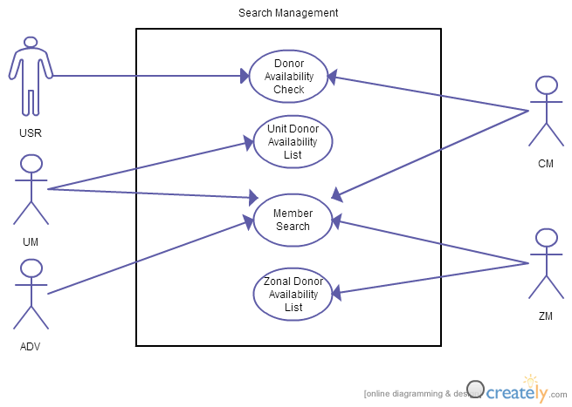
Fig : Use-Case Diagram for Search Management System

Slide 29
2.1 Donor Availability Check
Use-Case Name | Donor Availability Check
Use-Case ID | 2.1
Priority | High
Primary Business Actor | User (USR)
External Receiver Actor | User (USR)
Description | Returns Specific Donor Availability in the Nearest Badhan Zone
Trigger | By USR
Table : Use Case Narrative 2.1

Slide 30
2.1 Typical Course of Events
Actor Action | System Response
1. User Selects the Nearest Zone of Badhan
2. User then search if required blood donor is available in that zone | 3. System responded with yes /no
4. If no then user checks the other Badhan zone and if any donor available there | 5. System retrieve these information from database and inform the USR
6. User checks the contact information of the required zone | 7. System respond with contact informations & other process to make blood call

Slide 31
2.1 Documentation of Use-Case Donor Availability Check
Conclusion: User will get to know where and how to find blood donor promptly
Post-Condition: User come the Badhan office to verify and inform them about his required blood

Slide 32
2.2 Unit Donor Availability List
Use-Case Name | Unit Donor Availability List
Use-Case ID | 2.2
Priority | High
Primary Business Actor | Unit Member(UM)
Description | System informs about the available donor, their current blood donation statistics and contact information of the required blood group in the respective units
Trigger | By UM
Table : Use Case Narrative 2.2

Slide 33
2.2 Typical Course of Events
Actor Action | System Response
1. Unit member queries about the required blood group | 2. System extracts information about the donor of the respective blood group from database and provide with their necessary information
3. Unit member checks donor’s current blood donation statistics and queries if blood donation possible
4. Unit member contact with donor & confirms

Slide 34
2.2 Documentation of UseCase Unit Donor Availability List
Conclusion: Unit member will find the available donor as well as their contact information and blood donation statistics
Post-Condition: Unit member then tries to contact with the available donor and finds out who are willing to donate blood that time
Implementation Issues: The extraction of available donor is maintained by system database

Slide 35
2.3 Zonal Donor Availability List
Use-Case Name | Zonal Donor Availability List
Use-Case ID | 2.3
Priority | High
Primary Business Actor | Zonal Member(ZM)
Description | System informs about the available donor, their current blood donation statistics and contact information of the required blood group donors of all units of the respective zone
Trigger | By ZM
Table : Use Case Narrative 2.3

Slide 36
2.3 Typical Course of Events
Actor Action | System Response
1. ZM queries about the required blood group | 2. System extracts information about the donor of the respective blood group from database and provide with their necessary information
3. ZM checks donor’s current blood donation statistics and queries if blood donation possible
4. ZM contact with donor & confirms

Slide 37
2.3 Documentation of UseCase Zonal Donor Availability List
Conclusion: ZM will find the available donor as well as their contact information and blood donation statistics
Post-Condition: ZM then tries to contact with the available donor and finds out who are willing to donate blood that time
Implementation Issues: the entire extraction of available donor out of the huge list and preparing list is maintained by system database

Slide 38
2.4 Member Search
Use-Case Name | Member Search
Use-Case ID | 2.4
Priority | Normal
Primary Business Actor | UM,ZM,CM,ADV
Description | Search & Returns All Current or Previous Badhan Members Information & Unit / zonal / Central Committee List
Trigger | By UM,ZM,CM,ADV
Table : Use Case Narrative 2.4

Slide 39
2.4 Typical Course of Events
Actor Action | System Response
1. UM,CM,ZM,ADV search/query about any Badhan member or Unit/Zonal/Central Committee List | 2. System provides the member information or Committee list

Slide 40
2.4 Documentation of Use Case Member Search
Conclusion: All the Badhan members can be up to date with other members current status, contact informations
Post-Condition: CM,ZM,UM,ADV can find out any query relating to current , past Badhan members
Implementation Issues: the list of member information is managed by system database

Slide 41
3. Meeting Management
Use-Case ID > Name | Description | Participant Actors
3.1 > Zonal Event Creation | UM, ZM create new event | UM,ZM
3.2 > Zonal New Post | UM, ZM ,ADV create new discussion | UM,ZM,ADV
3.3 > Zonal Post Moderation | UM, ZM modify a post if necessary | UM,ZM
3.4 > Zonal Post Remove | Only MOD remove a post if necessary | MOD
3.5 > Central Event Creation | CM create new central event | CM
3.6 > Central New Post | CM,ZM,ADV create new discussion | CM,ZM,ADV
3.7 > Central Post Moderation | CM modify a post if necessary | CM
3.8 > Central Post Remove | Only ADM remove a post if necessary | ADM

Slide 42
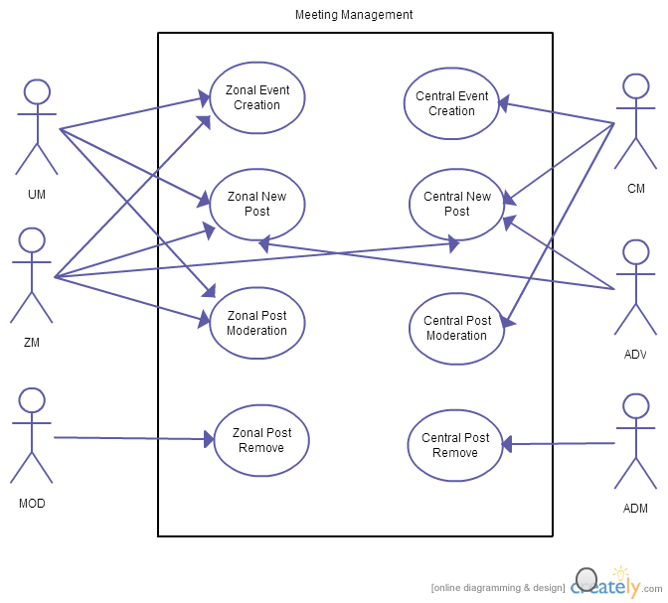
Fig : Use-Case Diagram for Meeting Management System

Slide 43
3.1 Zonal Event creation
Use-Case Name | Zonal Event Creation
Use-Case ID | 3.1
Priority | High
Primary Business Actor | UM,ZM
Description | UM,ZM create new event
Trigger | UM,ZM
Table : Use Case Narrative 3.1

Slide 44
3.1 Typical Course of Events
Actor Action | System Response
1. UM,ZM create event | 2. Notification Sent to respective UM,ZM,ADV
3. UM,ZM,ADV response accordingly

Slide 45
3.1 Documentation of Use-Case Zonal Event Creation
Conclusion : Concludes when the event date is expired
Post Condition : According to External Receiver Actor’s feedback

Slide 46
3.2 Zonal New Post
Use-Case Name | Zonal New Post
Use-Case ID | 3.2
Priority | High
Primary Business Actor | UM, ZM, ADV
Description | UM,ZM,ADV create new discussion
Trigger | By UM, ZM, ADV
Table : Use Case Narrative 3.2

Slide 47
3.2 Typical Course of Events
Actor Action | System Response
1. UM, ZM, ADV create new discussion | 2. Notification Sent to respective UM, ZM, ADV
3. UM, ZM, ADV response accordingly

Slide 48
3.2 Documentation of Use-Case Zonal New Post
Conclusion : When MODs remove the post
Post Condition : According to External Receiver Actor’s feedback

Slide 49
3.3 Zonal Post Moderation
Use-Case Name | Zonal Post Moderation
Use-Case ID | 3.3
Priority | High
Primary Business Actor | UM,ZM
Description | UM,ZM modify a post if necessary
Trigger | By UM,ZM
Typical Course of Event | UM,ZM modify a post if necessary
Table : Use Case Narrative 3.3

Slide 50
3.3 Documentation of Use-Case Zonal Post Moderation
Conclusion : Concludes when a MOD remove the post
Post Condition : According to MOD’s action

Slide 51
3.4 Zonal Post Remove
Use-Case Name | Zonal Post Remove
Use-Case ID | 3.4
Priority | Normal
Primary Business Actor | MOD
Description | Only MOD remove a post if necessary
Trigger | By MOD
Typical Course of Event | MOD remove a post if necessary
Table : Use Case Narrative 3.4

Slide 52
3.4 Documentation of Use-Case Zonal Post Remove
Conclusion : Concludes immediately

Slide 53
3.5 Central Event Creation
Use-Case Name | Central Event Creation
Use-Case ID | 3.5
Priority | Normal
Primary Business Actor | CM
External Receiver Actor | CM,ZM,ADV
Description | CM create new central event
Trigger | By CM
Table : Use Case Narrative 3.5

Slide 54
3.5 Typical Course of Events
Actor Action | System Response
1. CM create event | 2. Notification Sent to CM,ZM & ADV
3. CM, ZM & ADV response accordingly

Slide 55
3.5 Documentation of Use-Case Central Event Creation
Conclusion : Concludes when the event date is expired
Post Condition : According to External Receiver Actor’s feedback

Slide 56
3.6 Central New Post
Use-Case Name | Zonal New Post
Use-Case ID | 3.6
Priority | Normal
Primary Business Actor | CM, ZM, ADV
Description | CM, ZM, ADV create new discussion
Trigger | By CM, ZM, ADV
Table : Use Case Narrative 3.6

Slide 57
3.6 Typical Course of Events
Actor Action | System Response
1. CM, ZM, ADV create new discussion | 2. Notification Sent to respective CM, ZM, ADV
3. CM, ZM, ADV response accordingly

Slide 58
3.6 Documentation of Use-Case Central New Post
Conclusion : When ADM remove the post
Post Condition : According to External Receiver Actor’s feedback

Slide 59
3.7 Central Post Moderation
Use-Case Name | Zonal Post Moderation
Use-Case ID | 3.3
Priority | Normal
Primary Business Actor | CM
Description | CM modify a post if necessary
Trigger | By CM
Typical Course of Event | CM modify a post if necessary
Table : Use Case Narrative 3.7

Slide 60
3.7 Documentation of Use-Case Central Post Moderation
Conclusion : Concludes when ADM remove the post
Post Condition : According to ADM action

Slide 61
3.8 Central Post Remove
Use-Case Name | Central Post Remove
Use-Case ID | 3.8
Priority | Normal
Primary Business Actor | ADM
Description | Only ADM remove a post if necessary
Trigger | By ADM
Typical Course of Event | ADM remove a post if necessary
Table : Use Case Narrative 3.8

Slide 62
3.8 Documentation of Use-Case Central Post Remove
Conclusion : Concludes immediately

Slide 63
4. Notification Management
Use-Case ID > Name | Description | Participant Actors
4.1 > Donor Notification | Emergency blood call’s notification sent to available donor | DNR,UM
4.2 > Zonal Meeting Notification | Zonal Meeting Notification sent to UM,ZM,ADV | Time,UM,ZM,ADV
4.3 > Central Meeting Notificatin | Central Meeting Notification sent to CM,ZM,ADV | Time,CM,ZM,ADV

Slide 64
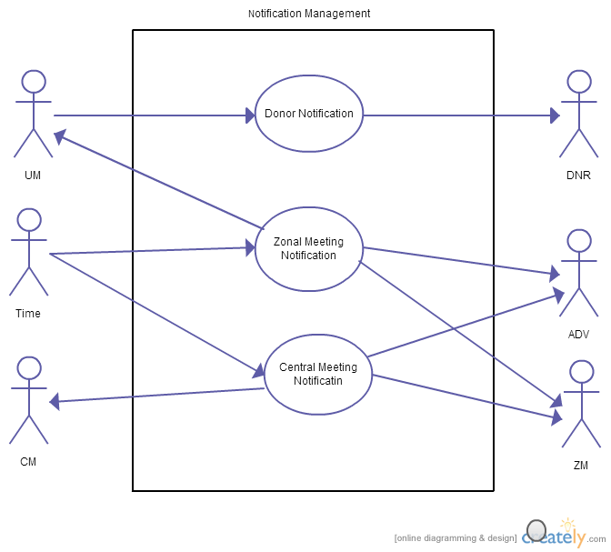
Fig : Use-Case Diagram for Notification Management System

Slide 65
4.1 Donor Notification
Use-Case Name | Zonal Event Creation
Use-Case ID | 4.1
Priority | High
Primary Business Actor | UM
External Receiver Actor | DNR
Description | Emergency blood call’s notification sent to available DNR
Trigger | By UM
Table : Use Case Narrative 4.1

Slide 66
4.1 Typical Course of Events
Actor Action | System Response
1. Notification sent to donor
2.UM receives DNR reply

Slide 67
4.1 Documentation of Use-Case Donor Notification
Conclusion : Concludes when DONR replies
Post Condition : According to DONR’s feedback

Slide 68
4.2 Zonal Meeting Notification
Use-Case Name | Zonal Meeting Notification
Use-Case ID | 4.2
Priority | High
Primary Business Actor | Time
External Receiver Actor | UM,ZM,ADV
Description | Zonal Meeting Notification sent to UM,ZM,ADV
Trigger | By Time
Typical Course of Event | System sends notification to UM,ZM,ADV
Table : Use Case Narrative 4.2

Slide 69
4.2 Documentation of Use-Case Zonal Event Notification
Conclusion : Concludes when notification is sent.

Slide 70
4.3 Central Event Notification
Use-Case Name | Zonal New Post
Use-Case ID | 4.3
Priority | Normal
Primary Business Actor | Time
External Receiver Actor | CM, ZM, ADV
Description | Central Meeting Notification sent to CM,ZM,ADV
Trigger | By System
Typical Course of Event | System sends notification to CM,ZM,ADV
Table : Use Case Narrative 4.3

Slide 71
4.3 Documentation of Use-Case Central Event Notification
Conclusion : Concludes when notification is sent.

Slide 72
5. Automated Requisition Form
Use-Case ID > Name | Description | Participant Actors
5.1 > Scan & Upload Requisition form | The requisition form is scanned and uploaded by user to send to UM. | USER (USR)
5.2 > Verification of Requisition Form | The uploaded requisition form is verified by both HR and UM. | HOSPITAL REPRESENTATIVE (HR), UNIT MEMBER(UM)

Slide 73
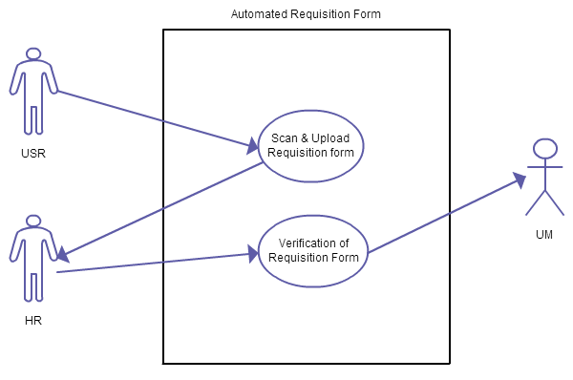
Fig : Use-Case Diagram for Automated Requisition Form

Slide 74
5.1 Scan & Upload Requisition form
Use-Case Name | Scan & Upload Requisition Form
Use-Case ID | 5.1
Priority | High
Primary Business Actor | USER(USR)
External Receiver Actor | HR, UM
Description | The requisition form is scanned and uploaded by user to send to UM & HR.
Trigger | By USR
Table : Use Case Narrative 5.1

Slide 75
5.1 Typical Course of Events
Actor Action | System Response
1. USER uploads the requisition form after scanning it.
2. UM & HR gets the scanned form to check over it.

Slide 76
5.1 Documentation of Use-Case: Scan & Upload Requisition Form
Conclusion : Concludes when the scanned requisition form is uploaded.

Slide 77
5.2 Verification of Requisition Form
Use-Case Name | Verification of Requisition Form
Use-Case ID | 6.2
Priority | High
Primary Business Actor | HR, UM
External Receiver Actor | HR
Description | The uploaded requisition form is verified by both HR and UM.
Trigger | By HR & UM.
Table : Use Case Narrative 5.2

Slide 78
5.2 Typical Course of Events
Actor Action | System Response
HR verifies the requisition form. | 2. Sends Verification form to UM.
3.UM receives the scanned requisition form

Slide 79
5.2 Documentation of Use-Case Verification of Requisition Form
Conclusion : Concludes when search for donor by the UM is completed.

Slide 80
End

